Slide 1
Creating Systemic Change
Gregory D. Abowd
Dean, College of Engineering

Slide 2
Many separate DEI efforts
Complex problem
Gaps in individual solutions
Notes:
And with that, there are numerous DEI initiatives addressing the challenge in their communities. Many organizations and educational institutions at all levels have implemented efforts to address the challenge but efforts are often conducted at the individual organization and institution level or at limited scale, and I a way they can best support within the scope of the need for their community and their abilities – resources, capabilities, expertise. Driving change is not easy and increasing diversity in engineering is a complex challenge. Through these individual initiatives, organizations and educational institutions have built areas of specialties, strengths and have weaknesses. No one is an expert in all areas—often part of the solution can’t be addressed alone; a gear or more is missing or not optimum to provide a holistic solution. But each individually has expertise that if shared can contribute to quality holistic solutions for themselves and others.

Slide 3
Shared goal
Create a resilient engineering workforce
Notes:
All of us have a shared goal of increasing diversity and yet efforts are often independent rather than collaborative, causing duplication of efforts and resources, as well as inefficiencies. Success of efforts are also limited by our own areas of expertise.

Slide 4
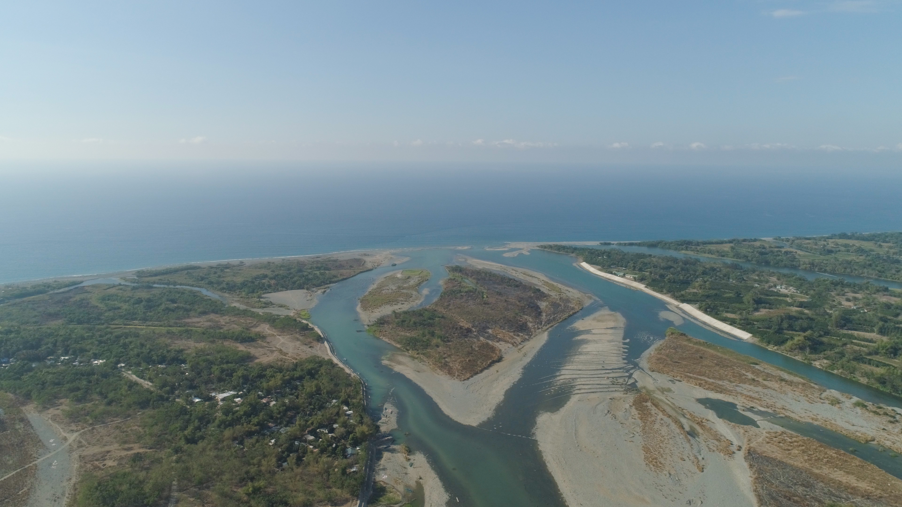
Creating a Resilient Engineering Workforce
Recruitment into
Retention within
Resilience afterwards
Market engineering to broader communities
Collaboration is key
Creating a safe and welcoming experience for all
Provide skills and confidence to maintain career after graduation
Notes:
Aligns with common agenda of EPLUS
Retention
also includes the culture and climate at the institution
We haven’t engaged the deans as much as we need to
Move from competitors to collaborators
We are buiding on what has happened from the past
but it is still not a national effort
ADRP was trying to be this effort
Industry is moving away from the pipeline metaphor
use pathways instead
Lots of on-ramps/off-ramps… a highway metaphor
braided riverways replaces the leaky pipeline
Sanky diagrams
Join EPLUS now, but know it is going to move to ASEE to be a more effective national effort
nominate for PEER academy

Slide 5
Underrepresented Populations in Engineering
Source: Georgetown University Center on Education and the Workforce
Notes:
A study by the Georgetown University Center on Education and the Workforce found that of the early 1.7 million prime-age engineering workers in the United States in 2019, 81% were either White or Asian/Asian American, and 84% were men. Just 3% were Latinx or Black women.
This slide shows that between 1990 and 2019, the total number of Black/African American and Latinx students who graduated with a bachelor’s degree in engineering increased nearly four-fold, but there is still far from equitable representation. At this rate it could take 76 years for all Black/African American and Latinx workers and up to 256 years for Black/African American Workers alone to achieve racial equity.

Slide 6
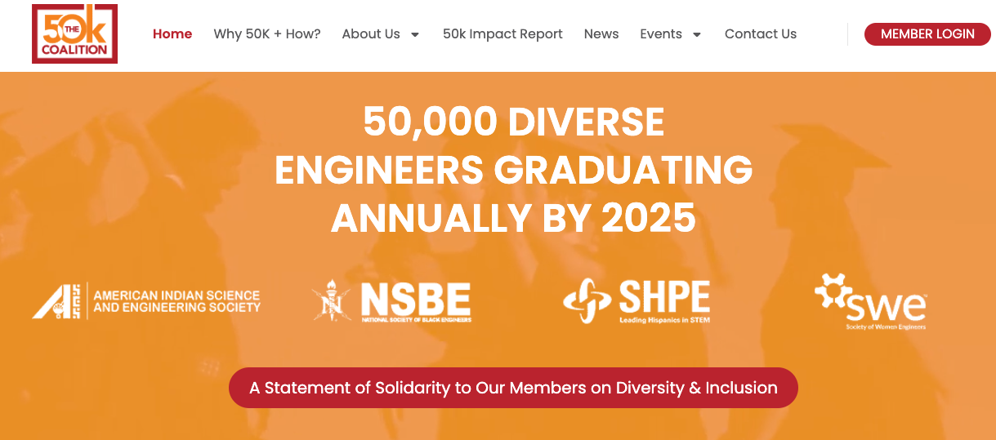
Unify to Achieve Goals Nationally
We know what to do
We have yet to scale effectively
Louis Stokes Alliances for Minority Participation LSAMP
50kcoalition.org
Notes:
I propose a call to action to Rethink the approach to increasing engineering diversity. To create systemic change we need to come together as a nationwide community – sharing our knowledge, partnering to improve our programs, ……….etc… ….. And by eliminating redundancies, it will also allow us to further diversity efforts to expand from focusing on select underrepresented populations (e.g., women, BIPOC, LGBTQ+, physically disabled, neurodiverse) to the needs of all diverse groups within our society.
NSF LSAMP also as a regional/national mechanism
Engineering societies
ASEE

Slide 7
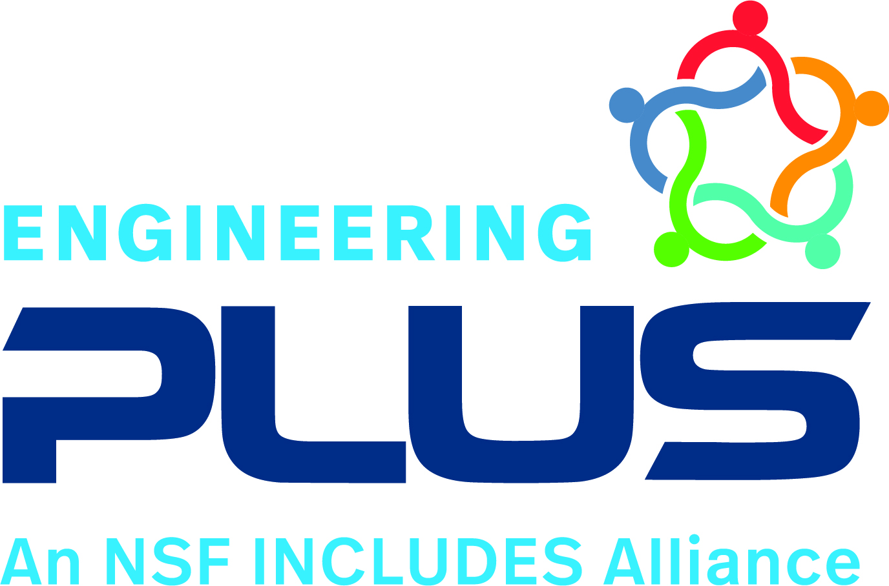
Engineering PLUS Scaling known best practices
Create a nationwide network of institutional change agents.
Develop a regional strategy to think globally and act locally

Slide 8
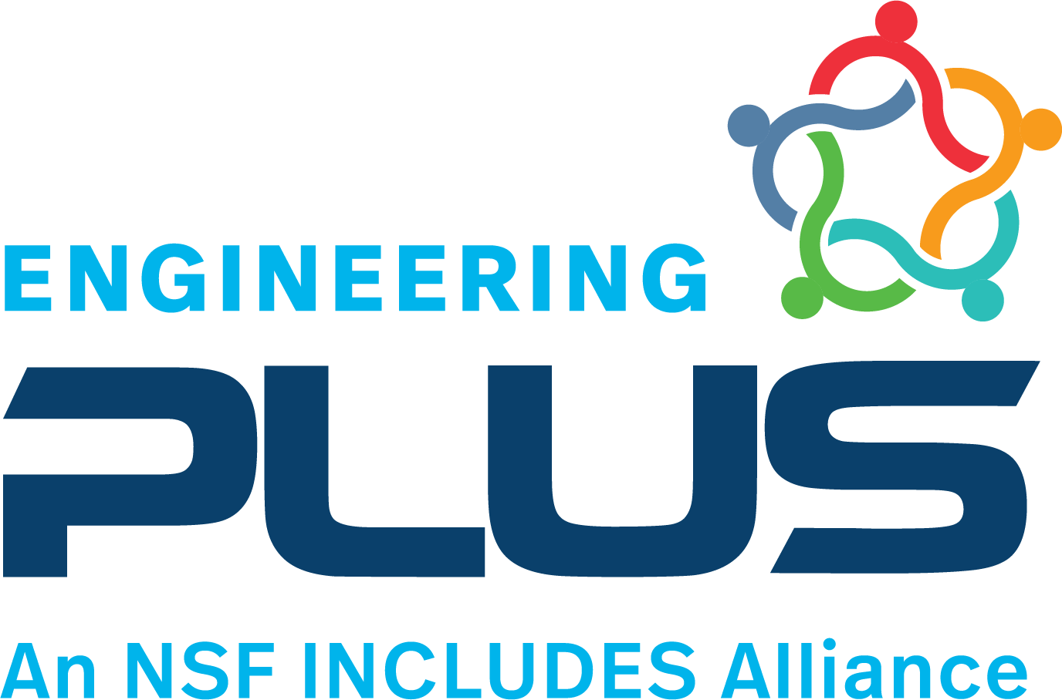
Network of Change Agents
Train, empower, and resource a national network of stEm PEERs
Goal 400 members by 2026
Impact within home institutions and beyond
2-year professional development and research experience
Design and implement an engineering-focused project at home institution
Submit project outcomes as publications and proposals
EngPLUS stEm PEER Academy
Notes:
Within each hub, peer academies are being established to provide faculty and staff professional development. E-PLUS trains, empowers, resources, and supports a national network of stEm* PEERs (Practitioners Enhancing Engineering Regionally); They are change agents who will accelerate the implementation of high-impact, evidence-based practices within their home institutions and beyond.
*“E” emphasizes Engineering in Science, Technology, Engineering, Mathematics.
Results to date: Goal increased from 140 members to now 400 before the end of 2026. Two cohorts totaling 60 members of higher education have completed a Peer Academy program and a third cohort is beginning training in 2024. As a stEm PEER, participants become a network of institutional change agents. They accelerate the implementation of high-impact, evidence-based practices within their home institutions and beyond.

Slide 9
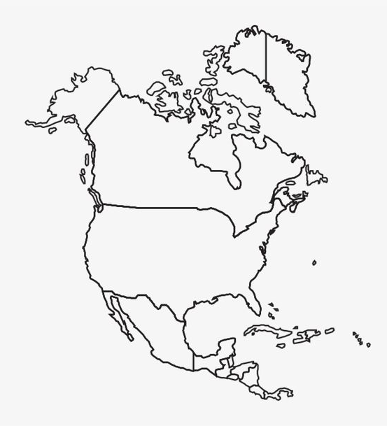
Coordinated Regional Hubs
Alliances of networked universities, community colleges, K-12
Leverage existing NSF LSAMPs
Build an inclusive infrastructure to drive and sustain systemic change
Share best practices, promote cross-campus student engagement in research and industrial learning
Notes:
To successfully approach program adoption in a systematic way, E-PLUS is creating and supporting five regional hubs across the country, three of which are now established. They are helmed by leaders of NSF-funded Louis Stokes Alliances for Minority Participation and create collective alliances of networked universities, community colleges, and K-12 schools. The hubs share best practices, promote cross-campus student engagement in research and industrial learning to advance a more diverse engineering workforce.

Slide 10
A Path Towards Sustainable Unity

Slide 11
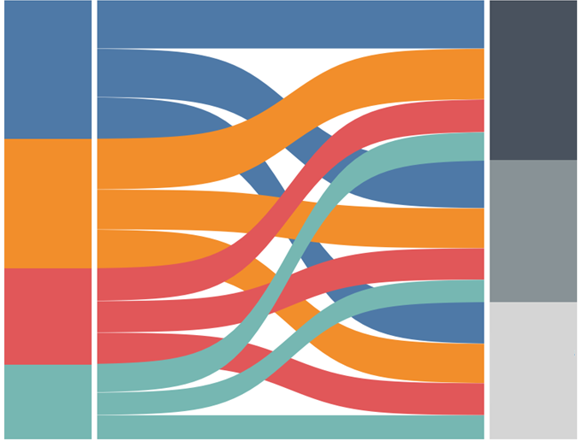
Creating a Resilient Engineering Workforce
K-12
Post-secondary
Workforce
Recruitment into
Retention within
Resilience afterwards
Market engineering to broader communities
Creating a safe and welcoming experience for all
Provide skills and confidence to maintain career after graduation
Notes:
Aligns with common agenda of EPLUS
Retention
also includes the culture and climate at the institution
We haven’t engaged the deans as much as we need to
Move from competitors to collaborators
We are buiding on what has happened from the past
but it is still not a national effort
ADRP was trying to be this effort
Industry is moving away from the pipeline metaphor
use pathways instead
Lots of on-ramps/off-ramps… a highway metaphor
braided riverways replaces the leaky pipeline
Sanky diagrams
Join EPLUS now, but know it is going to move to ASEE to be a more effective national effort
nominate for PEER academy

Slide 12
Underserved Populations in Engineering
ADHD
Attention Hyperactivity
15-20% of general population
Neurodivergent STEM graduates experience:
Unemployment rate of 30%
Underemployment as high as 80%
Tourette Syndrome
ASD
Autism Spectrum
Intellectual/Learning Disabilities
Dyslexia
Other
Conditions
Notes:
A study by the Georgetown University Center on Education and the Workforce found that of the early 1.7 million prime-age engineering workers in the United States in 2019, 81% were either White or Asian/Asian American, and 84% were men. Just 3% were Latinx or Black women.
This slide shows that between 1990 and 2019, the total number of Black/African American and Latinx students who graduated with a bachelor’s degree in engineering increased nearly four-fold, but there is still far from equitable representation. At this rate it could take 76 years for all Black/African American and Latinx workers and up to 256 years for Black/African American Workers alone to achieve racial equity.

Slide 13
Neurodivergent Student Challenges
Completing College
Accessing Services
Employment
Lack of awareness (Ableism)
Higher drop-out rate
Time to receive diagnosis
Not all students disclose
Intersectionality
Obtaining
Maintaining
Notes:
Explain why this cause is needed.

Slide 14
coe.northeastern.edu/neurodiversity
Trainings for Faculty and Support Staff
Graduate
Experience
Programs for Self-Advocacy, Leadership, and Self-Identity
Undergraduate
Experience
Intersectionality
Neurodiverse Talent & Engineering Workforce
Co-ops and Internships
Employer Education and Workplace Transformation
Programs for Private Sector Workforce Development
14
Notes:
How you are working together and the value of the shared expertise through the partnership vs. going it alone and explain NU’s co-op advantage last.

Slide 15
Unite for Nationwide Impact
Recruitment into
Retention within
Resilience afterwards
Market engineering to broader communities
Creating a safe and welcoming experience for all
Provide skills and confidence to maintain career after graduation
engplusalliance.northeastern.edu
coe.northeastern.edu/neurodiversity

Slide 16
Thank You

